Slide 1

Hack
the waste
Team: Lucky 7

Slide 2
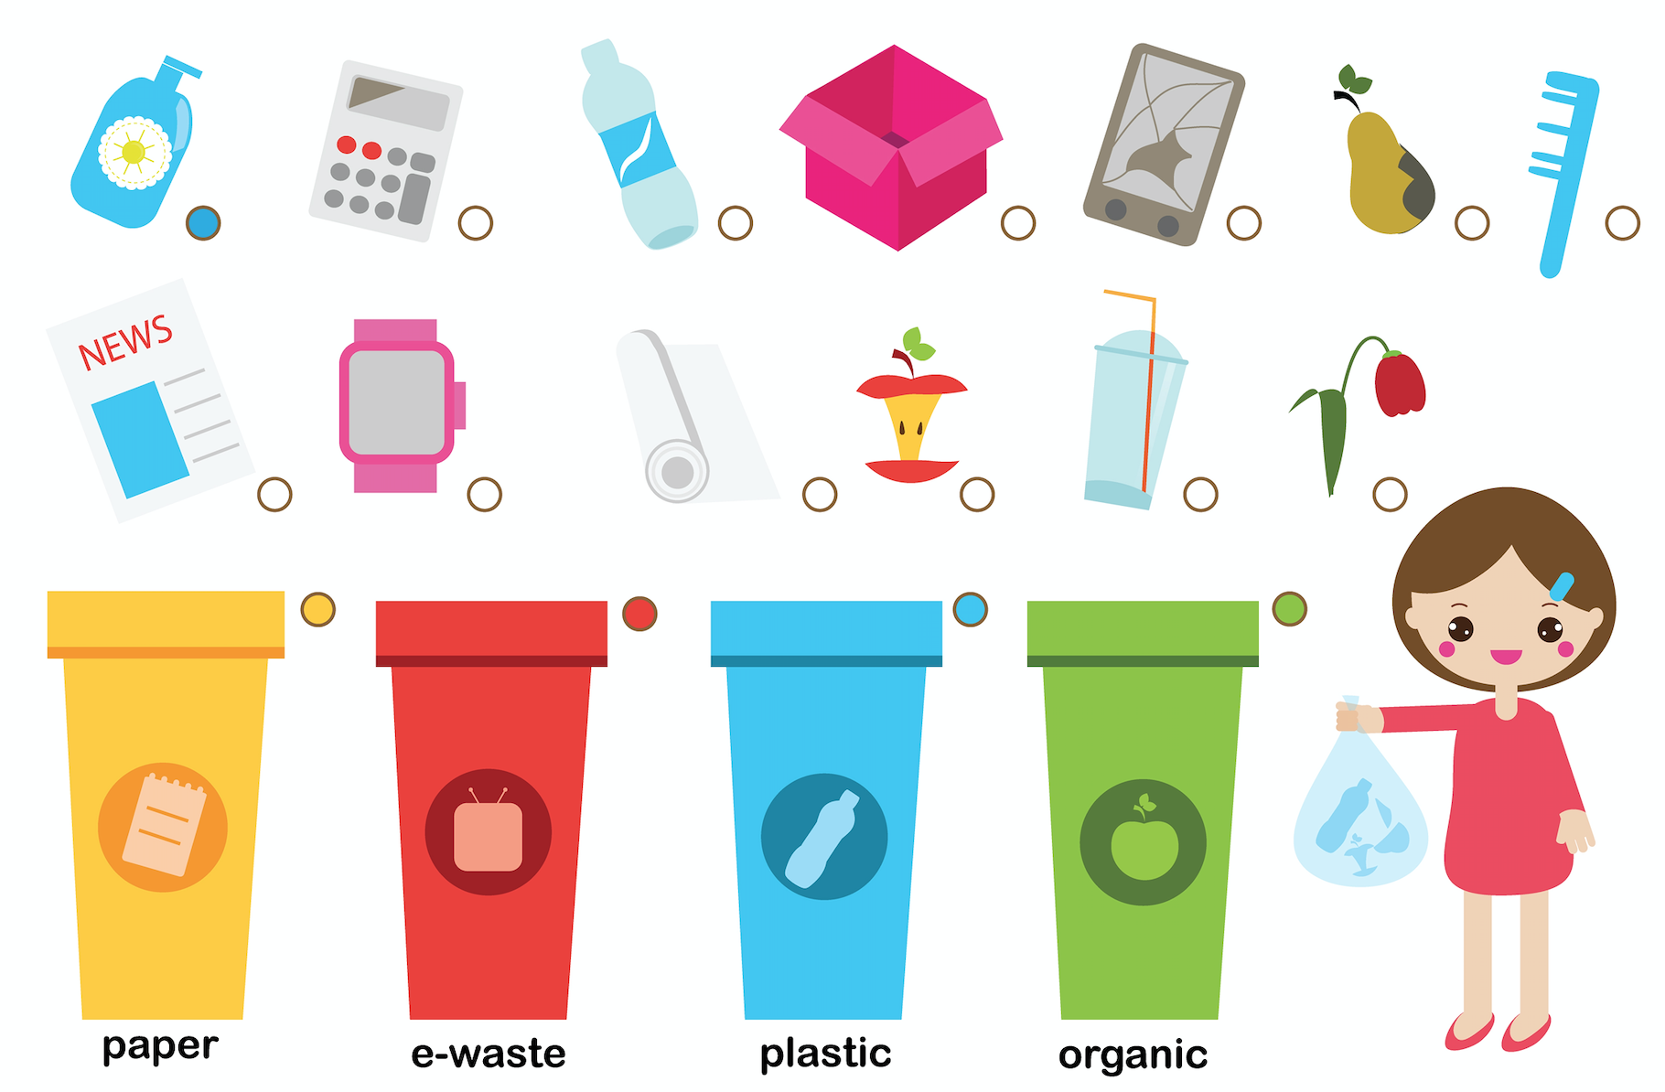

Problem
Large quantity of garbage produced daily
Insufficient knowledge about recycling

Slide 3
Our Solution - Recycle racers
Main purpose: to educate children, youth or an adult about proper recycling / to inspire behavioral changes
Goals of the Game:
How each garbage type should be recycled
Rise awareness with interesting facts and through game

Slide 4

Target audience
B2C Main target: Kids 5 - 12 years old Adults 25 - 40 years old
B2B and B2G Schools and public libraries Kindergartens Different public Places and events
Notes:
We will be targeting also parents - to get to the main target group, parents like games with learning note

Slide 5
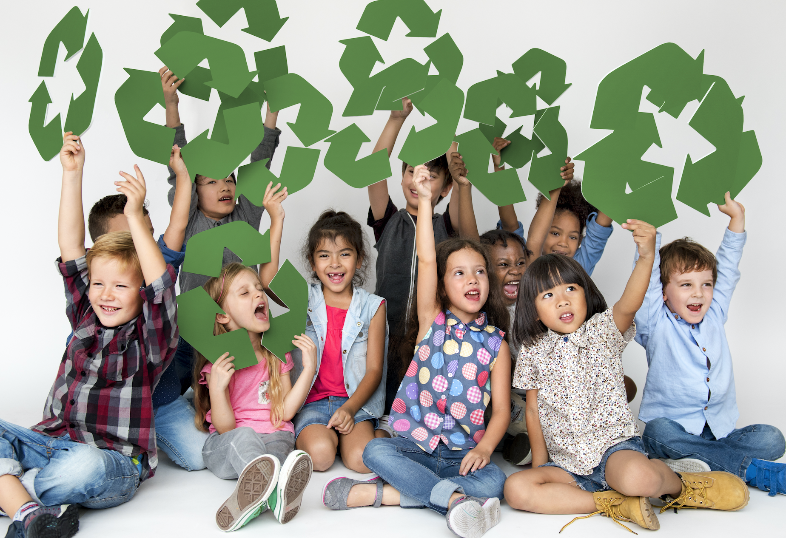
B2C -Value proposition
Educating children and adults On proper recycling
Combining: Education + Fun + Excitement
Competitiveness
No similar games combining recycling + racing
Singleplayer/Multiplayer

Slide 6

B2B / B2G -Value proposition
Attracting Parents with young children
Positive PR (raising awareness)
Corporate Social Responsibility

Slide 7
Channels
We will be targeting our audience through:
Sponsors - Companies, public organisations webpage
Gaming platform - Steam; Origin (Online gaming libraries)
Schools, Kindergartens (for educational purposes)
Public locations (interactive stands)
Social networks - youtube, facebook, instagram
Main Website (later in the year)
Cross sell - with other game (later in the year) - like Minecraft - Talking Tom

Slide 8
Business model
Potential sponsors
One time non-profit project (long term profit project)
Costs to be covered by sponsors
Companies
Government funding
Schools - educational purposes
EU Funding

Slide 9

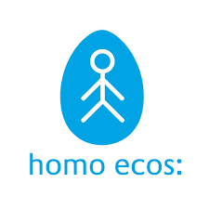


Potential sponsors
Waste management /
Environmentally friendly companies:
Example ''Getlini EKO'' ltd in Latvia

Slide 10


Potential sponsors
Government structures:
Ministry of Education and Science
Estlat.eu (grant support)
Notes:
Changing the curriculum, Pressure from EU to invest in environmental awareness education

Slide 11
SWOT ANALYSIS
STRENGTHS | WEAKNESS
Inspire behavioral changes Learning and informing through fun and excitement Free for users | Can be copied If the game is not continuously upgraded with new stuff, there is the risk that we we lose the players that we gained
OPPORTUNITIES | THREATS
Can reach a large circle of our target group Opportunities (online game, changeable, upgradable, etc.) Scale up the project with interactive stands in public places | No financial support (investors, sponsors) Dependence from the partners

Slide 12

Estimated costs
No. | Action item | Period | Expense (EUR)
1 | Developing the Game | 2 months | 6000 €
2 | Creation of the teaser | December | 500 €
3 | Social media advertising | 10 months and more | 1000 €
4 | Sponsors advertising | 10 months and more | None
5 | Game reviews - YouTube | 3 months and more | None and 1000 €
6 | Schools and Kindergarten | 12 months | None
7 | Interactive stands | Depends on the duration | 9000 €
 |  | Together | 17500 € - (8500 €)

Slide 13
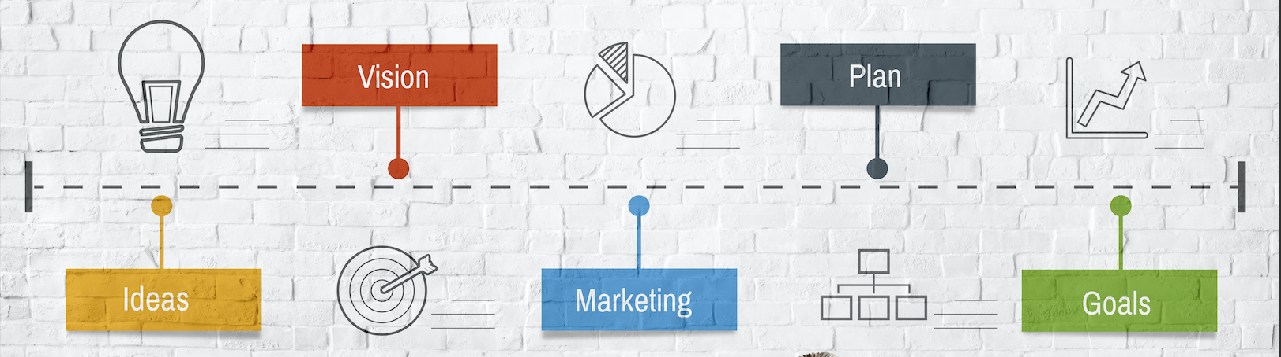
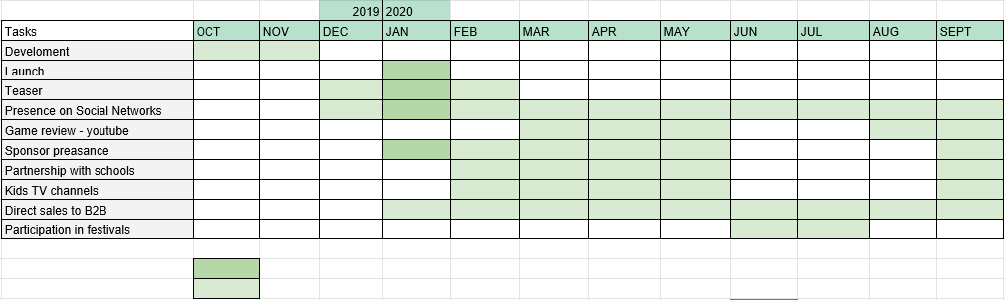
Marketing Plan
Starting phase:
Intense activity
Activity

Slide 14


Marketing plan -ADVERTISING
Teaser/Trailer
Launch
Daily posts (Instagram, FB page, Twitter page, YouTube)
Reviews by game influencers
Kids TV channels

Slide 15
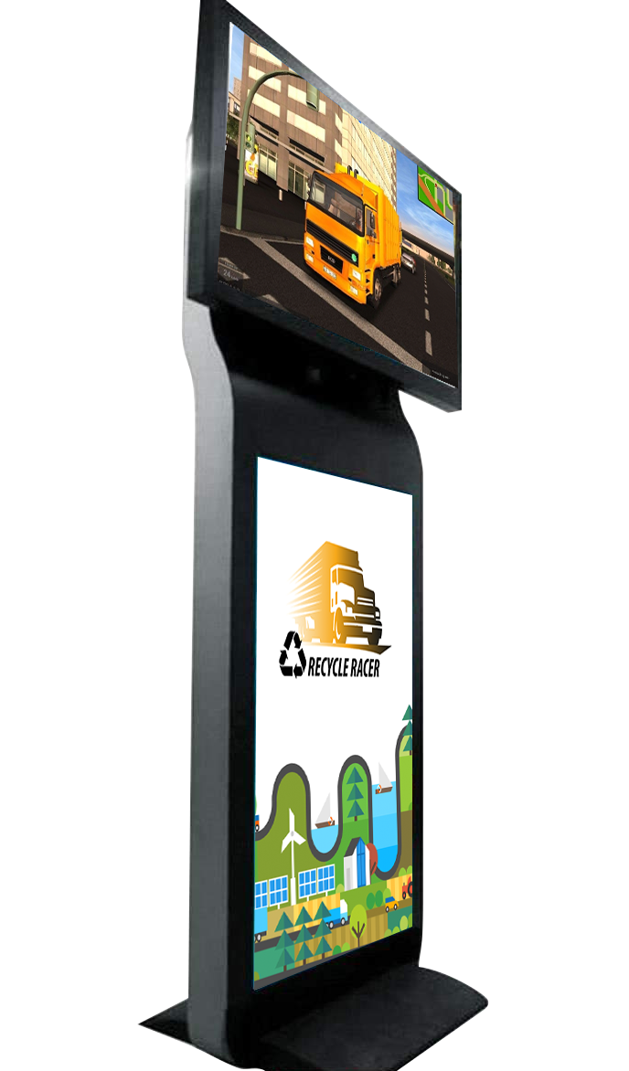
DIRECT PROMOTION
Interactive stands
Public locations: Festivals, shopping malls (kids room), airports, restaurants, fuel stations, libraries etc.

Slide 16

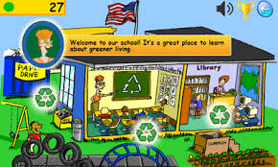
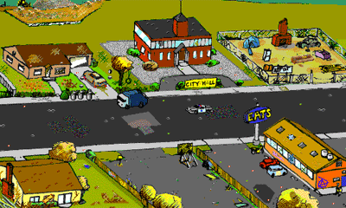
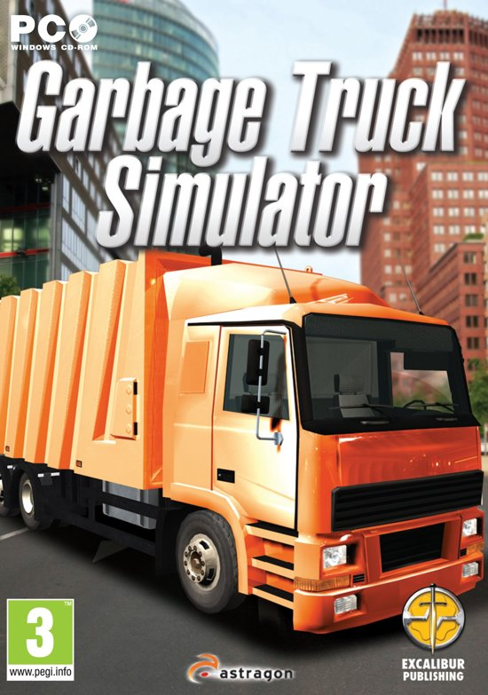
Competition
Garbage simulator
Racing games
Recycle City games (Dumptown Game, Recycle City Challenge)

Slide 17
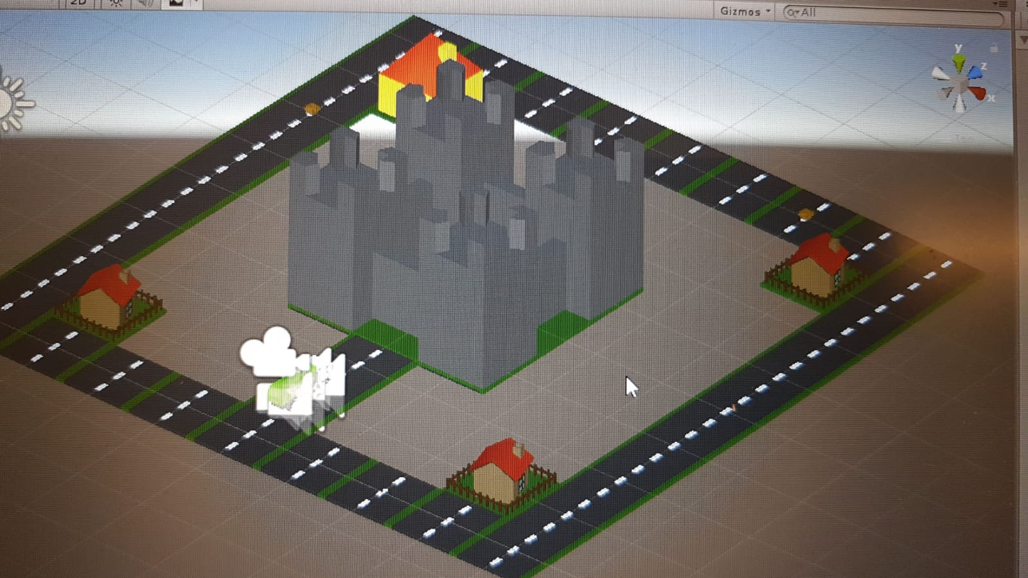
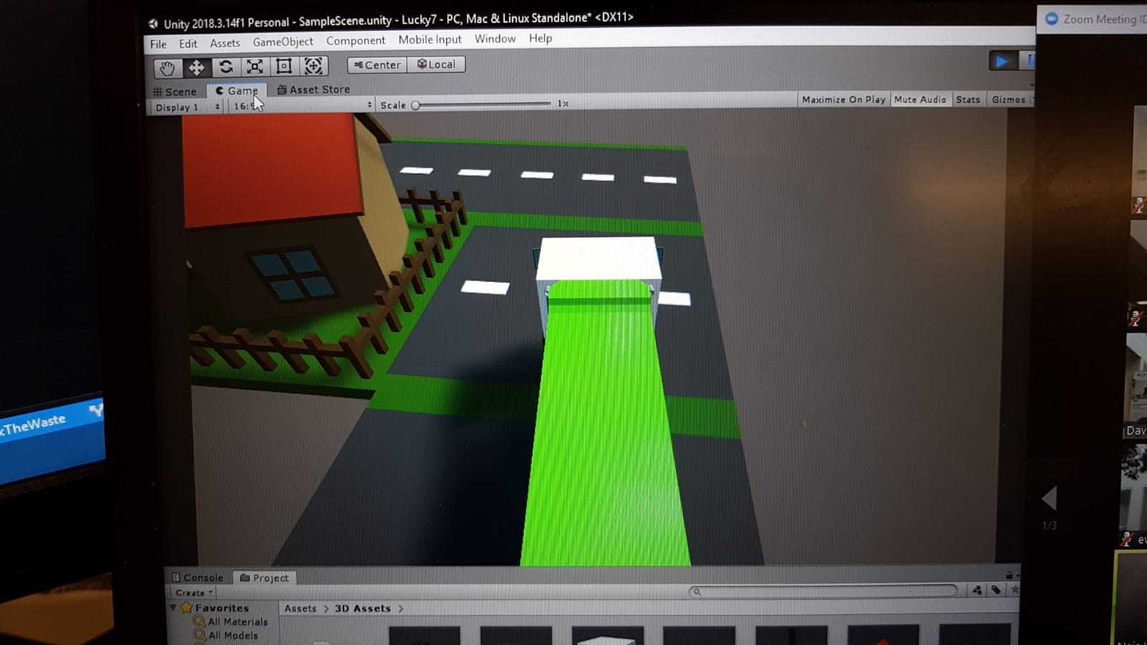
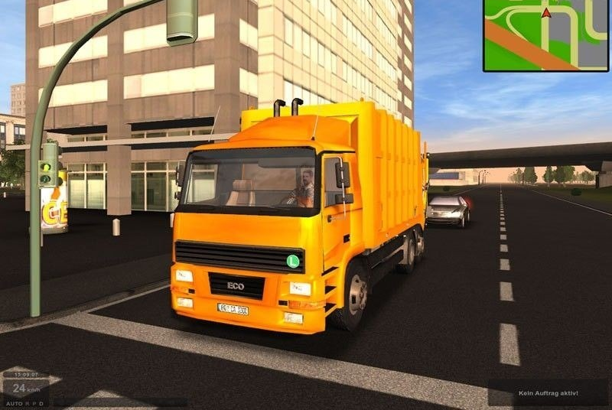
About the Game itself - Recycle racer
Garbage Truck
Collecting the right waste
Competition for points
Difficulty levels

Slide 18
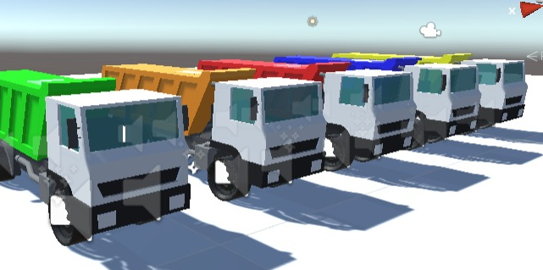
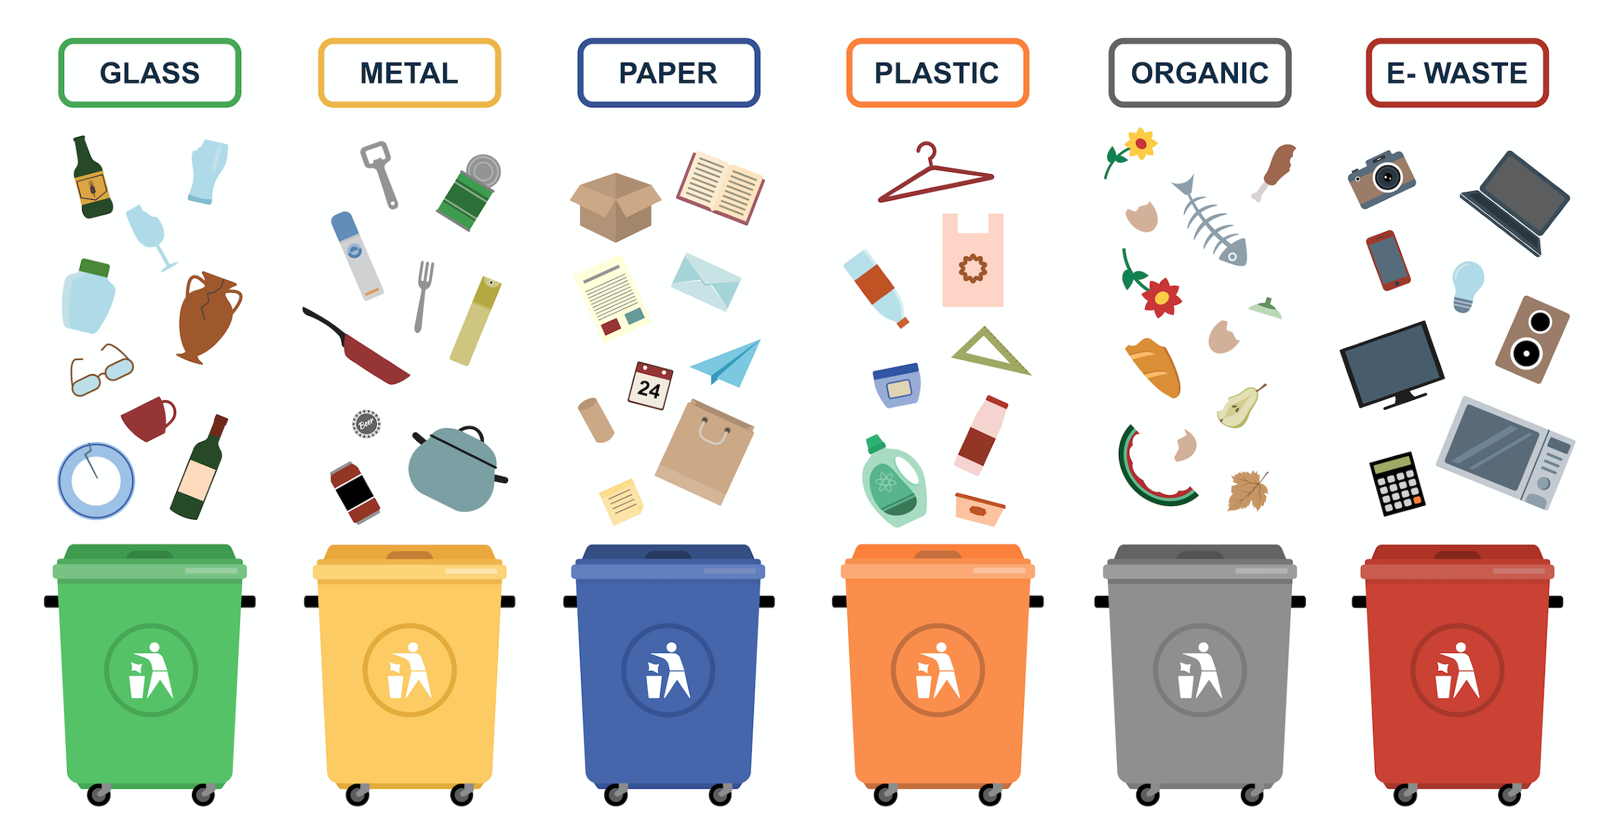
Design
3D - City view
Different trucks for each garbage type
Colors of the garbage are similar as the garbage recycle bins

Slide 19
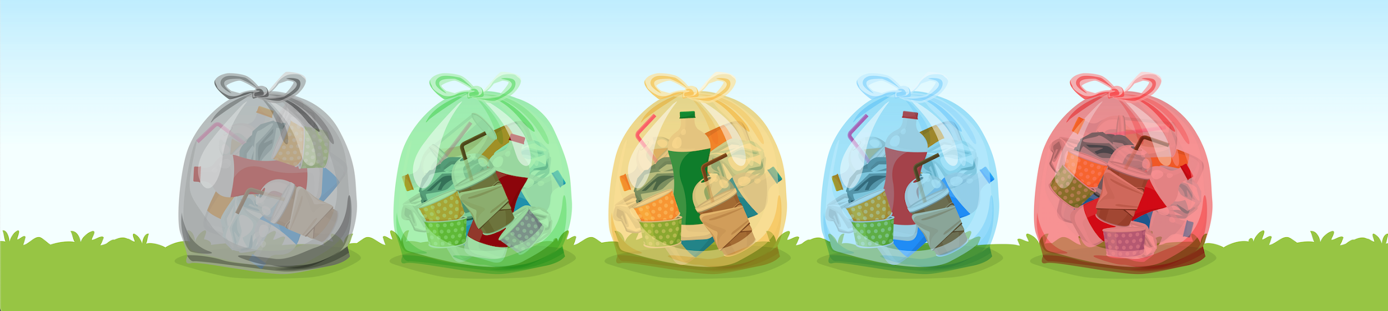
Task in the game / RULES OF THE GAME
Collecting the correct garbage type to gain points
Picking up a wrong type will result in minus points
Changing garbage truck to pick up other garbage types

Slide 20
